Slide 1

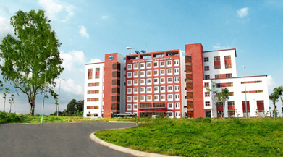
International University
MICRO-PROCESSING SYSTEM
Lecture 12:
Controller Area Network
Vo Minh Thanh, M.Eng
School Of Electrical Engineering

Slide 2
Intra-vehicular communication
A typical vehicle has a large number of electronic control systems
Some of such control systems
  Engine timing
  Gearbox and carburetor throttle control
  Anti-block systems (ABS)
  Acceleration skid control (ASC)
The growth of automotive electronics is a result of:
  Customers wish for better comfort and better safety.
  Government requirements for improved emission control
  Reduced fuel consumption

Slide 3
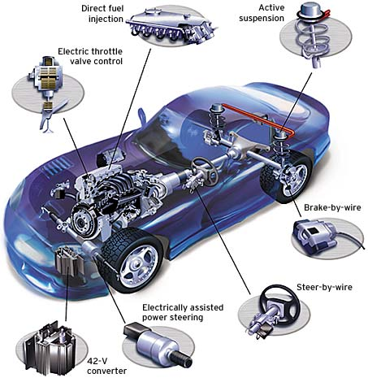
What are some real world applications of CAN?
  Controller Area Networks are used in many different fields, the bulk of which are
    Auto-motive industry
    Factory Automation
    Machine Control
    Medical Equipment and devices
    And more….

Slide 4
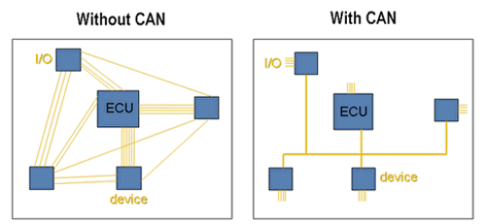
What is CAN and what are some of its features?
Serial communication
Multi-Master Protocol
Compact
  Twisted Pair Bus line
1 Megabit per second

Slide 5
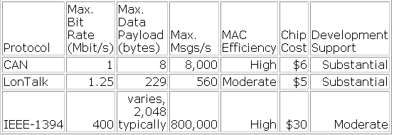
Why is CAN used?
  Robust in noisy environments
  Priority Signal Setting
  All devices on the network receive every bit of information sent on the BUS
  Cost Effective

Slide 6
How do we connect these control devices?
With conventional systems, data is exchanged by means of dedicated signal lines.
But this is becoming increasingly difficult and expensive as control functions become ever more complex.
In case of complex control systems in particular, the number of connections cannot be increased much further.
Solution: Use Fieldbus networks for connecting the control devices

Slide 7
Controller Area Network (CAN)
Controller Area Network (CAN) is a fast serial bus that is designed to provide
  an efficient,
  Reliable and
  Very economical link between sensors and actuators.
CAN uses a twisted pair cable to communicate at speeds up to 1Mbit/s with up to 40 devices.
Originally developed to simplify the wiring in automobiles.
CAN fieldbuses are now used in machine and factory automation products as well.

Slide 8
CAN features
Any node can access the bus when the bus is quiet
Non-destructive bit-wise arbitration to allow 100% use of the bandwidth without loss of data
Variable message priority based on 11-bit (or 29 bit) packet identifier
Peer-to-peer and multi-cast reception
Automatic error detection, signaling and retries
Data packets are 8 bytes long

Slide 9
Tradeoff: CAN bus versus point-to-point connections
By introducing one single bus as the only means of communication as opposed to the point-to-point network, we traded off the channel access simplicity for the circuit simplicty
Since two devices might want to transmit simultaneously, we need to have a MAC protocol to handle the situation.
CAN manages MAC issues by using a unique identifier for each of the outgoing messages
Identifier of a message represents its priority.

Slide 10
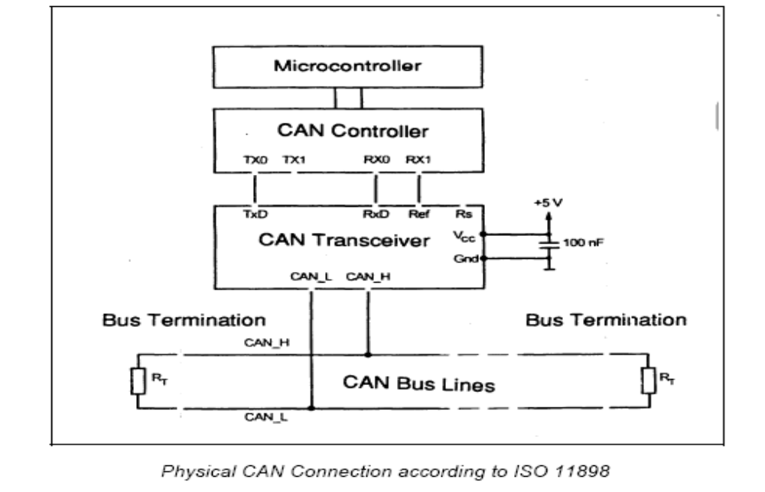
Physical CAN connection

Slide 11
CAN
CAN Station 1
CAN Station 5
CS1
CS2
CS3
CS4
CS5
CAN BUS

Slide 12
CAN Protocol - Version 2.0 A(standard)/B(Extended)
• A: Object, Transfer, and Physical Layers
– Object Layer: handles messages - selects transmit/receive
messages
– Transfer Layer: assures messages adheres to protocol
– Physical Layer: sends and receives messages
• B: Data Link Layer and Physical Layer

Slide 13
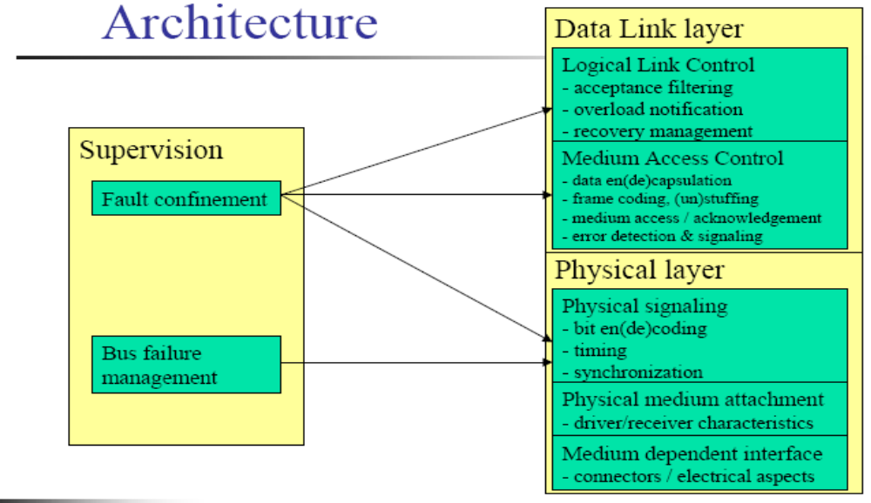

Slide 14
Physical Layer
Topology
- Terminated bus
Number of stations
-In principle limited to 30 (depends on drivers)
Medium
- Twisted pair, single wire
Range
-Signaling speed and propagation speed dependent: 40m at 1Mbit/s
-Drop length limited to 30 cm
Signaling and bit encoding
-10 kbit/s to 1 Mbit/s, NRZ

Slide 15
Physical Layer
Synchronization
- Uses signal edges (implies bit stuffing with NRZ)
- After Five consecutive ones, a zero is inserted
- After Five consecutive zeros, a one is inserted
-This rules includes a possible stuffing bit inserted before
Signals
- Recessive: logical “1”
- Dominant: logical “0”
- When two stations compete on a bit by bit basis, the station that emits dominant bit imposes this level on the bus

Slide 16
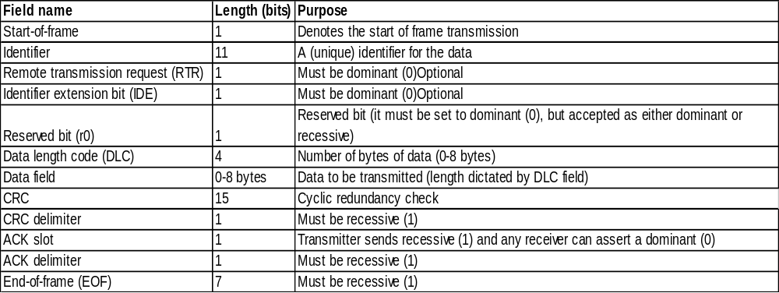
What is transmitted?
All messages sent over a CAN network follows this format. Each bit is used either to verify the validity of the message, or is data itself.

Slide 17
Basic message frame format
Field name | Length (bits) | Purpose
Start-of-frame | 1 | Denotes the start of frame transmission
Identifier | 11 | A (unique) identifier for the data
Remote transmission request (RTR) | 1 | Must be dominant (0)
Identifier extension bit (IDE) | 1 | Must be dominant (0)
Reserved bit (r0) | 1 | Reserved bit (it must be set to dominant (0), but accepted as either dominant or recessive)
Data length code (DLC) | 4 | Number of bytes of data (0-8 bytes)
Data field | 0-8 bytes | Data to be transmitted (length dictated by DLC field)
CRC | 15 | Cyclic redundancy check
CRC delimiter | 1 | Must be recessive (1)
ACK slot | 1 | Transmitter sends recessive (1) and any receiver can assert a dominant (0)
ACK delimiter | 1 | Must be recessive (1)
End-of-frame (EOF) | 7 | Must be recessive (1)

Slide 18
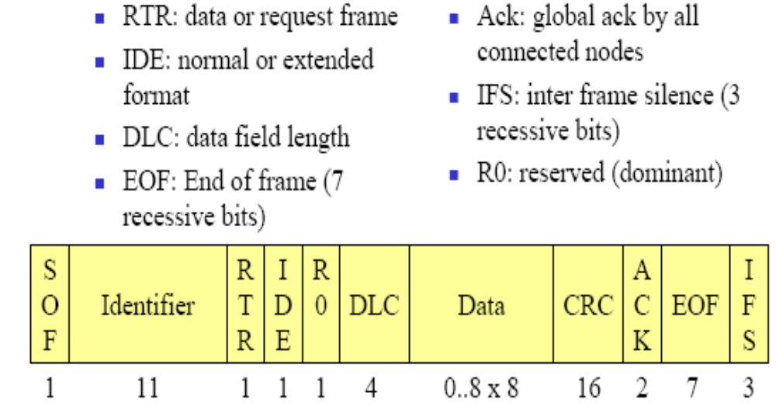
Medium Access Control Frame

Slide 19
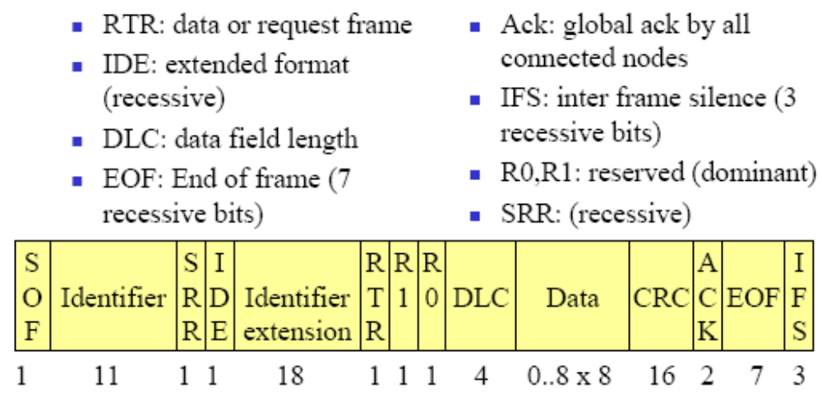
Extended Addressing

Slide 20
Addressing
Single 11 or 29 bit identifier per frame
  If used to identify a node
    Source(data) or Destination(request) of the message
  Normally used to identify the payload
  A lower value gives higher value in contention,

Slide 21
Error Detection
Several means
Bit error
  When what is one the bus is different from what was emitted
    Except when a recessive bit was emitted during arbitration or ack slot
Cyclic Redundancy Check (CRC)
Frame check (the frame structure is checked)
ACK errors (absence of a dominant bit during the ack slot)
Monitoring (each node which transmits also observes the bus level and thus detects differences between the bit sent and the bit received).

Slide 22
Error Detection
Bit stuffing (checking adherence to the stuffing rule.)
A frame is valid for
  A transmitter if there is no error until the end of EOF
  A receiver if there is no error until the next to last bit of EOF

Slide 23
Behavior in case of error
In case of stuff, bit, form or acknowledge errors
  An error flag is started at the next bit
In case of CRC error
  An error frame is send after the ack delimiter
Fault confinement
  Each time an reception error occurs, REC is incremented
  Each time a frame is received correctly, REC is decremented
  Same for the emission errors with TEC
  The values of TEC and REC may trigger mode changes

Slide 24
Connection Modes
To enforce fault confinement, nodes may be in one of three modes
Error active
  Normally takes part to the communication and may send an active error flag (six dominant consecutive bits) when an error has been detected.
Error passive
  Takes part in communication but must not send an active error flag. Instead, it shall send a passive error flag (six recessive consecutive bits)
  Some restrictions (silence between two tx).

Slide 25
Connection Modes
Bus off
  Cannot send or receive any frame.
  A node is in this state when it is switched of the bus due to a request from a fault confinement entity. May exit from this state only by a user command

Slide 26
Error Frame
Two fields: Error flag and Error delimiter
Error flag
  Active: Six dominant bits
  Passive: Six recessive bits
  As all nodes monitor the bus and the flag violates stuffing rules, they will send error flags too
    The error flag will last from 6 to 12 bits

Slide 27
Error Frame
Error delimiter (Eight recessive bits)
  After sending an error flag, a node shall send recessive bits
  As soon as it senses a recessive bit, it sends seven recessive bits

Slide 28
Error Recovery
Automatic retransmission
  Of all frames that have lost arbitration
  Of all frames have been disturbed by errors during
transmission

Slide 29
Medium Access Control
All messages are sent in broadcast
Nodes filter according to their interest
All messages are acknowledged including by nodes that are not interested by the message
  Acknowledge just means “message well received by all receivers”
    It does not mean “intended receiver received it”

Slide 30
Medium Access Control
Node that does not receive message correctly sends an error bit sequence
Node that is too busy may send an overload bit seq.
  MA_OVLD.request/indication/confirm
  Same principle as an error

Slide 31
Logical Link Control
Two types of services (connectionless)
  Send Data with no ack
    L_DATA.request, L_DATA.indication, L_DATA.confirm
    Uses a data frame
  Request Data
    L_REMOTE.request,L_REMOTE.indication,L_REMOTE.confirm
    Uses a remote frame (same as a data frame but data field is empty)
  Flow control using the overload bit sequence

Slide 32
Implicit collision handling in the CAN bus
If two messages are simultaneously sent over the CAN bus, the bus takes the “logical AND” of all them
Hence, the messages identifiers with the lowest binary number gets the highest priority
Every device listens on the channel and backs off as and when it notices a mismatch between the bus’s bit and its identifier’s bit

Slide 33
Implicit collision handling in the CAN bus: example
Node B notices a mismatch in bit # 3 on the bus.
Therefore, it stops transmitting thereafter
1
1
1
BUS
0
0
0
0
0
0
1
1
1
Node A’s
message-ID
0
0
0
0
0
0
1
1
1
1
Node B’s
message-ID
0
0
0
0
0
Unlike the MAC protocols we learnt, in CAN a collision does not result in wastage of bandwidth.
Hence, CAN achieves 100% bandwidth utilization

Slide 34
References
http://www.fieldbus.com.au/techinfo.htm#Top
http://www.esd-electronics.com/german/PDF-file/CAN/Englisch/intro-e.pdf
http://www.eng.man.ac.uk/mech/merg/FieldbusTeam/Fieldbus%20Introduction.htm#_Toc487265349

